Slide 1
Statistical Inference
Estimation
Any of numerous procedures used to calculate the value of some property of a population from observations of a sample drawn from the population.
Point Estimate vs Interval Estimate
A point estimate, for example, is the single number most likely to express the value of the property. An interval estimate defines a range within which the value of the property can be expected (with a specified degree of confidence) to fall.
law of large numbers,
In statistics, the theorem that, as the number of identically distributed, randomly generated variables increases, their sample mean (average) approaches their theoretical mean

Slide 2
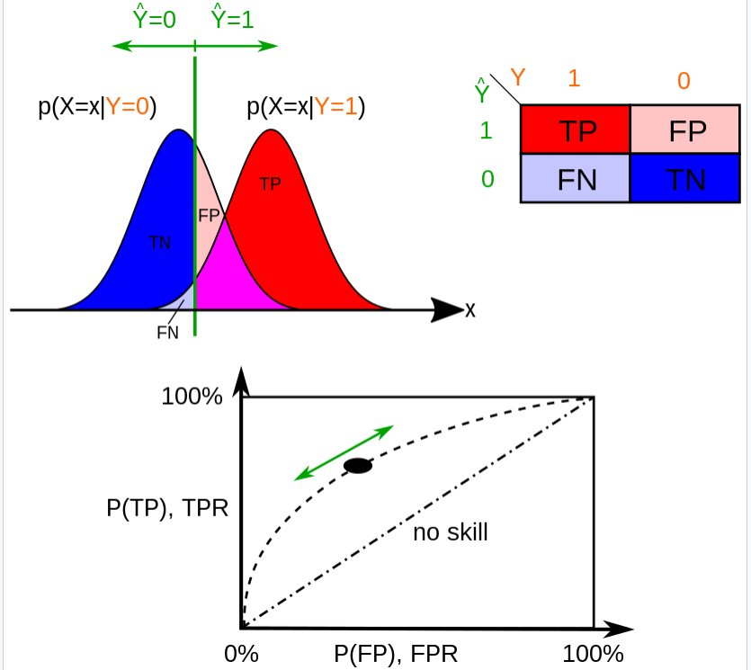
Type I error : Reject H0/Ho is true.
The first kind of error is the mistaken rejection of a null hypothesis as the result of a test procedure. This kind of error is called a type I error (false positive) and is sometimes called an error of the first kind. In terms of the courtroom example, a type I error corresponds to convicting an innocent defendant.
Type II error :Accept H1/ H1 is false .
The second kind of error is the mistaken failure to reject the null hypothesis as the result of a test procedure. This sort of error is called a type II error (false negative) and is also referred to as an error of the second kind. In terms of the courtroom example, a type II error corresponds to acquitting a criminal.

Slide 3
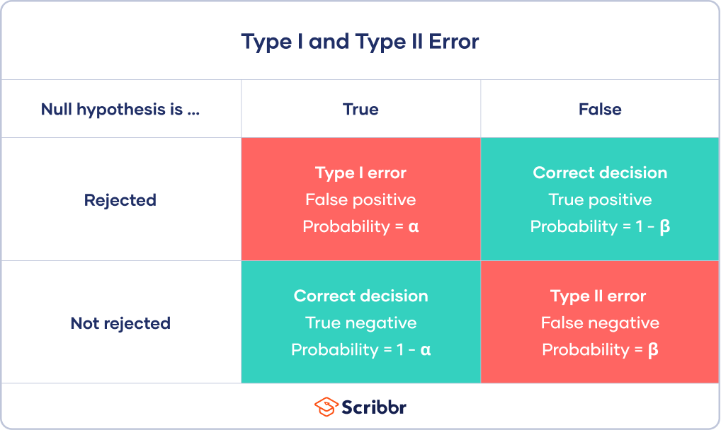

Slide 4
Level of Significance Symbol
The level of significance is denoted by the Greek symbol α (alpha). Therefore, the level of significance is defined as follows:
Significance Level = p (type I error) = α
The values or the observations are less likely when they are farther than the mean. The results are written as “significant at x%”.
Example: The value significant at 5% refers to p-value is less than 0.05 or p < 0.05. Similarly, significant at the 1% means that the p-value is less than 0.01.
The level of significance is taken at 0.05 or 5%. When the p-value is low, it means that the recognised values are significantly different from the population value that was hypothesised in the beginning. The p-value is said to be more significant if it is as low as possible. Also, the result would be highly significant if the p-value is very less. But, most generally, p-values smaller than 0.05 are known as significant, since getting a p-value less than 0.05 is quite a less practice.

Slide 5
What Are Degrees of Freedom?
Degrees of freedom refers to the maximum number of logically independent values, which are values that have the freedom to vary, in the data sample. Once the degrees of freedom quantity have been selected, specific data sample items must be chosen if there is a outstanding requirement of the data sample.
Statistical Significance ? In Statistics, “significance” means “not by chance” or “probably true”. We can say that if a statistician declares that some result is “highly significant”, then he indicates by stating that it might be very probably true. It does not mean that the result is highly significant, but it suggests that it is highly probable.
Level of Significance Definition
The level of significance is defined as the fixed probability of wrong elimination of null hypothesis when in fact, it is true. The level of significance is stated to be the probability of type I error and is preset by the researcher with the outcomes of error. The level of significance is the measurement of the statistical significance. It defines whether the null hypothesis is assumed to be accepted or rejected. It is expected to identify if the result is statistically significant for the null hypothesis to be false or rejected.

Slide 6
Statistical assumptions
Statistical tests make some common assumptions about the data they are testing:
Independence of observations (a.k.a. no autocorrelation): The observations/variables you include in your test are not related (for example, multiple measurements of a single test subject are not independent, while measurements of multiple different test subjects are independent).
Homogeneity of variance: the variance within each group being compared is similar among all groups. If one group has much more variation than others, it will limit the test’s effectiveness.
Normality of data: the data follows a normal distribution (a.k.a. a bell curve). This assumption applies only to quantitative data.
If your data do not meet the assumptions of normality or homogeneity of variance, you may be able to perform a nonparametric statistical test, which allows you to make comparisons without any assumptions about the data distribution.
If your data do not meet the assumption of independence of observations, you may be able to use a test that accounts for structure in your data (repeated-measures tests or tests that include blocking variables).

Slide 7
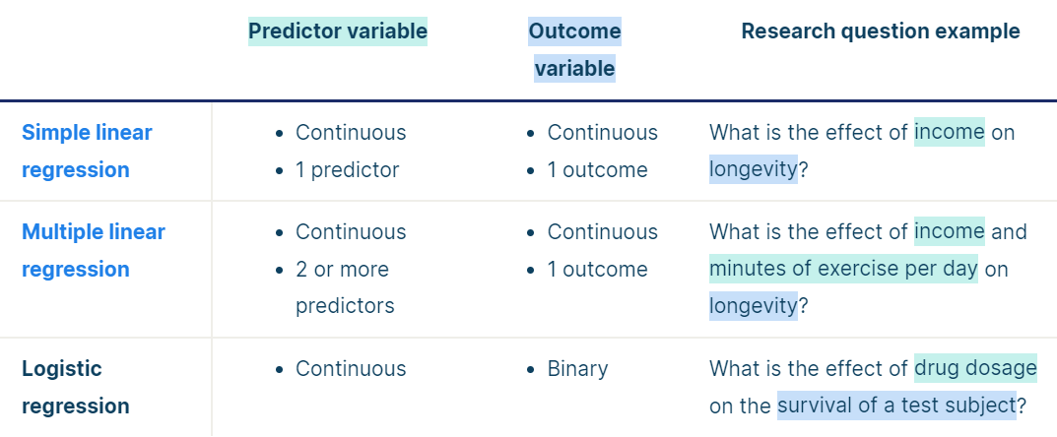
Choosing a parametric test: regression, comparison, or correlation
Parametric tests usually have stricter requirements than nonparametric tests and are able to make stronger inferences from the data. They can only be conducted with data that adheres to the common assumptions of statistical tests.
The most common types of parametric test include regression tests, comparison tests, and correlation tests.
Regression tests
Regression tests look for cause-and-effect relationships. They can be used to estimate the effect of one or more continuous variables on another variable.

Slide 8
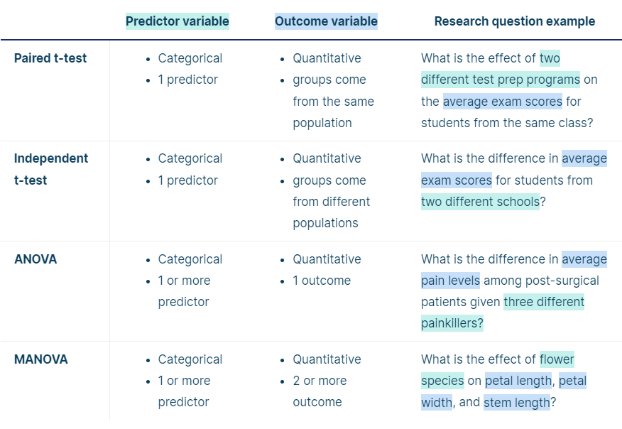
Comparison tests
Comparison tests look for differences among group means. They can be used to test the effect of a categorical variable on the mean value of some other characteristic.
T-tests are used when comparing the means of precisely two groups (e.g. the average heights of men and women). ANOVA and MANOVA tests are used when comparing the means of more than two groups (e.g. the average heights of children, teenagers, and adults).

Slide 9

Correlation tests
Correlation tests check whether variables are related without hypothesizing a cause-and-effect relationship.
These can be used to test whether two variables you want to use in (for example) a multiple regression test are autocorrelated.

Slide 10
